Slide 1
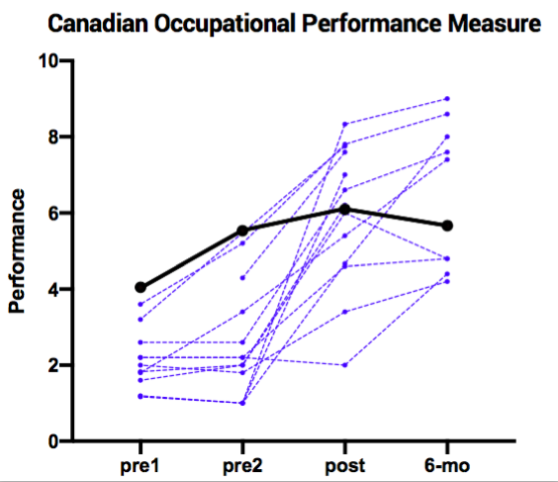
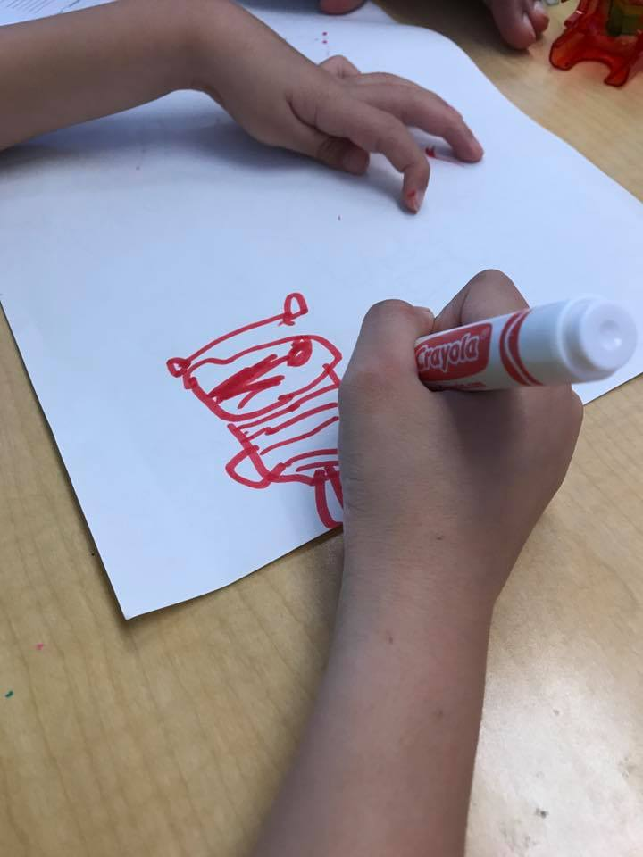
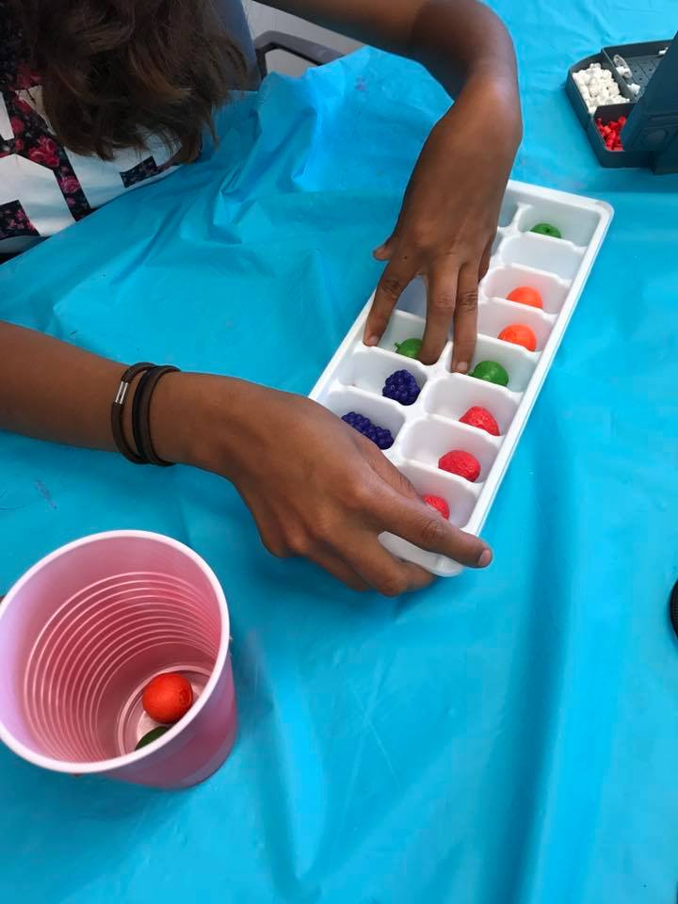
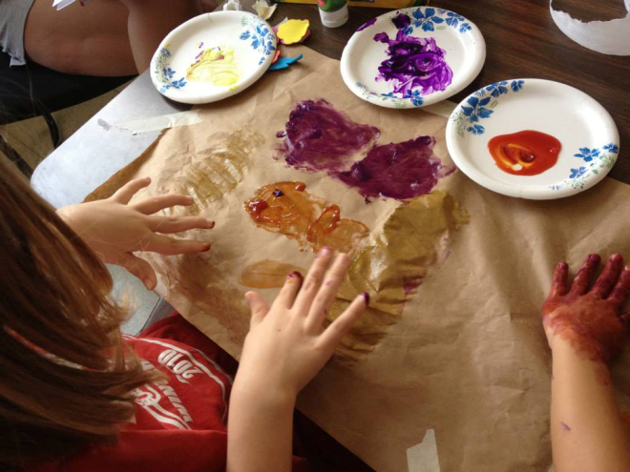
Hand-Arm Bimanual Intensive Training
in Children following Hemispherectomy Surgery
M.T. Robert, C.L. Ferre, K. Y. Chin, M. Brandao, J. Carmel, R. Araneda, Y. Bleyenheuft, K.F. Friel, A.M. Gordon
Dept. of Biobehavioral Sciences, Teachers College, Columbia University, New York, NY
Introduction
Methodology (continued)
Results
Hemispherectomy surgery is a procedure aimed at arresting seizure activity in individuals with intractable pharmaco-resistant epilepsy. Individuals who have had a hemispherectomy exhibit different degrees of hemiplegia on the contralateral body side, which is often associated with difficulties in performing activities of daily living.¹ Until recently, there has not been evidence supporting the efficacy of any UE treatment approach. One approach that has shown promise is Constraint-Induced Movement Therapy (CIMT). This procedure, originally developed for adults with hemiparetic stroke, was subsequently modified for use in children,^{2,3} involves restraint of the less affected UE and intensive training of the more affected UE. There is strong support for its use in children with mild to moderate congenital hemiplegia.⁴ One case series study suggests that CIMT may be a feasible method of rehabilitation in individuals with chronic hemiparesis post hemispherectomy surgery, and demonstrated reorganization of sensorimotor cortical representations of both hands.⁵
Despite it promise, CIMT may not be well-suited for individuals with more severe UE impairments due to the limited range of activities that can be successfully performed and the potential associated frustration. An alternative approach involving intensive bimanual training, Hand-Arm Bimanual Intensive Therapy (HABIT)⁶ has shown similar gains to CIMT in children with congenital hemiplegia.^{4,7}
Inclusion criteria:
Had undergone complete hemispherectomy surgery
Capable of participating in a 6 hour long day camp
Capable of following directions regarding hand use and testing
Capable of communication needs
Non-active seizure
Have active movement
Able to use the more affected arm as a stabilizer
Exclusion criteria:
unwillingness to comply with instructions
healthy problems unassociated with hemiplegia
visual impairment
orthopedic surgery on the more-affected hand
botulinum toxin in the more affected upper extremity
All 13 participants completed the full 90 hours of training.
Four children were unable to attend the follow-up assessment because of testing burden.
Technical difficulties accounted for two missing AHA scoring.
On average, children spent 96.7% (3.1%) of their time doing whole task practice and 3.0% (3.0%) on part task practice.
No significant improvements of the BBT across time points was observed (p>0.05).
Significant improvements across time points was observed for the JTTHF (p=0.004).
Five children out of 13 who had achieve maximum scores (1080s, reflecting an inability of the test to measure above that) did not demonstrate improvements.
Improvements of bimanual functions was also observed (p<0.001)
Significant improvements across time points was observed for the COPM and ABILHAND-Kids(p<0.001)
Intervention:
All participants underwent 90 hours of HABIT training in a day camp environment at Teachers College, Columbia University (n=11) or Université catholique de Louvain, Belgium (n=2).
Children were engaged in fine and gross motor activities individually chosen according to the child’s abilities to use the affected hand as a manipulator or stabilizer in order to achieve success to encourage bimanual use.
The activities chosen for goal training were selected according to the children’s and parents’ priorities, reported using the Canadian Occupational Performance Measure (COPM).
Whenever possible, part task practice was included (practice of specific components of the task in a repetitive sequence of 30 seconds)
All clinical measures were assessed by a blinded clinician twice before, immediately and 6 months after 90 hours of intervention.
Clinical outcomes:
Bimanual performance: Assisting Hand Assessment (AHA)
Unimanual dexterity:
1) Jebsen-Taylor Test of Hand Function (JTTHF)
2) Box and Block Test (BBT)
Perceived manual ability of children: ABILHAND-KIDS
Functional goals: Canadian Occupational Performance Measure (COPM)
Neuroimaging:
Diffusion Tensor Imaging: reconstruction of the corticospinal tracts to see if lateralization can be used an indicator for hand function.
Objective
Conclusion
The objective of this study was to assess the effectiveness of an intensive bimanual intervention on upper limb functions in children who have undergone hemispherectomy.
Completion of Hand-Arm Bimanual Intensive Therapy (HABIT) appears to be feasible in individuals who have had a hemispherectomy, and could be complimentary or a viable alternative to CIMT.
Lateralization could not be used as a predictor for hand function (small sample size)
Improvement of bimanual function and functional goals can be related to the nature of activities prioritized in HABIT
Future work should focus on bimanual performance and the neural substrates underlying these improvements in a larger sample of individuals.
Methodology
Study Design:
Acknowledgements
The authors thank the children and the families who participated in this study. We also thank the volunteers in their assistance with data collection. This study was supported by a grant from the Brain Recovery Project.
Participants:
13 children
9 males, 4 females
Age range 7.5 to 16.5
Mean age = 11.8 years
Mean age at surgery = 6.2 years
10 functional hemispherectomy and 3 anatomical
MACS score of II and III
References
Kupper H, Kudernatsch M, Pieper T, et al. Predicting hand function after hemidisconnection. Brain. 2016;139(Pt 9):2456-2468.
Gordon AM, Charles J, Wolf SL. Methods of constraint-induced movement therapy for children with hemiplegic cerebral palsy: development of a child-friendly intervention for improving upper-extremity function. Arch Phys Med Rehabil. 2005 Apr;86(4):837-44.Taub E, Griffin A, Nick J, Gammons K, et al. (2007). Dev Neurorehabil. 2007;10:3–18.
Novak I, McIntyre S, Morgan C, Campbell L, Dark L, Morton N, Stumbles E, Wilson SA, Goldsmith S. A systematic review of interventions for children with cerebral palsy: state of the evidence. Dev Med Child Neurol. 2013 Oct;55(10):885-910.Sakzewski et al. 2014
Gordon AM, Hung YC, Brandao M, Ferre CL, Kuo HC, Friel K, Petra E, Chinnan A, Charles JR. Bimanual training and constraint-induced movement therapy in children with hemiplegic cerebral palsy: a randomized trial. Neurorehabil Neural Repair. 2011 Oct;25(8):692-702
de Bode S, Fritz SL, Weir-Haynes K, Mathern GW. Constraint-induced movement therapy for individuals after cerebral hemispherectomy: a case series. Phys Ther. 2009 Apr;89(4):361-9.
Charles J, Gordon AM. Development of hand-arm bimanual intensive training (HABIT) for improving bimanual coordination in children with hemiplegic cerebral
palsy. Dev Med Child Neurol. 2006 Nov;48(11):931-6.
7. Sakzewski L, Ziviani J, Abbott DF, Macdonell RA, Jackson GD, Boyd RN. Randomized trial of constraint-induced movement therapy and bimanual training on activity outcomes for children with congenital hemiplegia. Dev Med Child Neurol. 2011 Apr;53(4):313-20.

