Slide 1
Hearing after Hemispherectomy
Hemispherectomy Conference and Family Reunion
Selected comments on ……
Frank E. Musiek, Ph.D., CCC-A
Professor and Director
NeuroAudiology Lab
University of Arizona

Slide 2
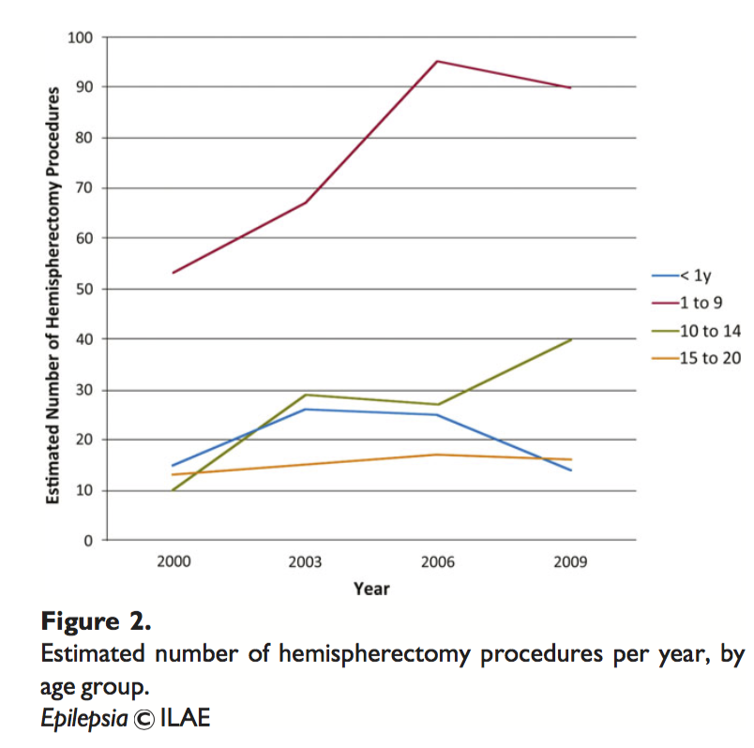
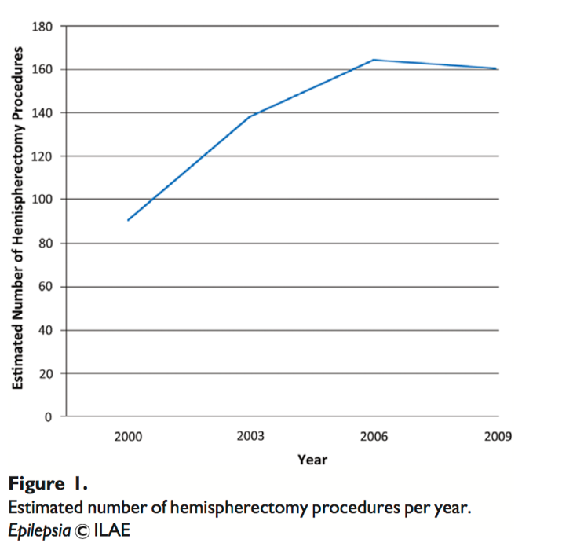
Incidence: hemispherectomy
2.2 per 100,000 in 2009
1.2 per 100,000 in 2000
(from Lin et al. 2015)

Slide 3
Peripheral and Central Auditory Systems…..
-they must work together but they do different jobs !

Slide 4
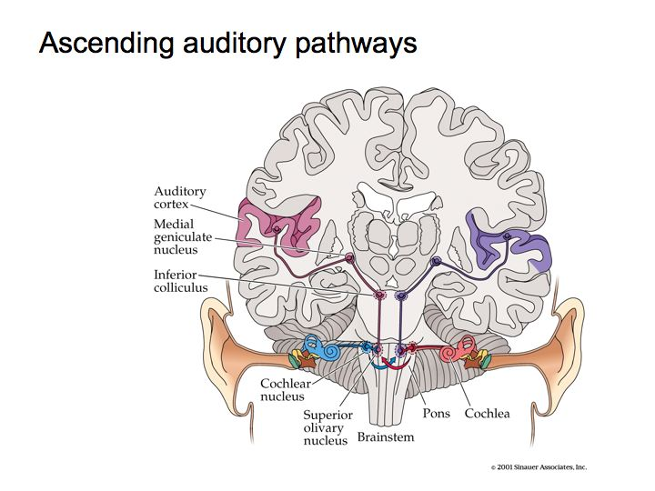
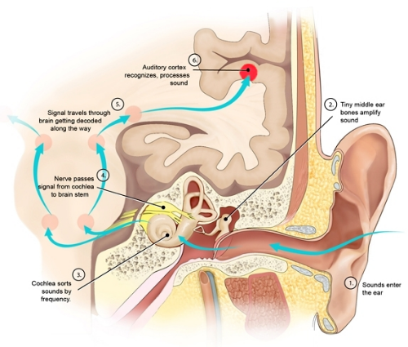
Peripheral and Central Auditory Systems…..
From San Fancisco spch & Hearing Ctr.

Slide 5
COMPLEX VERSUS NOT SO COMPLEX SYSTEMS
HIGH
Central system
DEGREE OF
INVOLVEMENT/
EFFICIENCY
Peripheral system
NONE
LOW
HIGH
COMPLEXITY OF ACOUSTIC STIMULUS AND OR TASK

Slide 6
What are simple and complex acoustic signals or tasks ?
SIMPLE
COMPLEX
PURE TONES/DETECTION
SPEECH/DICHOTIC
TONES/LOCALIZATION
OTHER…..

Slide 7
The traditional hearing test – the pure tone audiogram, measures one’s
ability for the detection (and sensitivity) of tones for various frequencies.
It requires a YES or NO response.

Slide 8
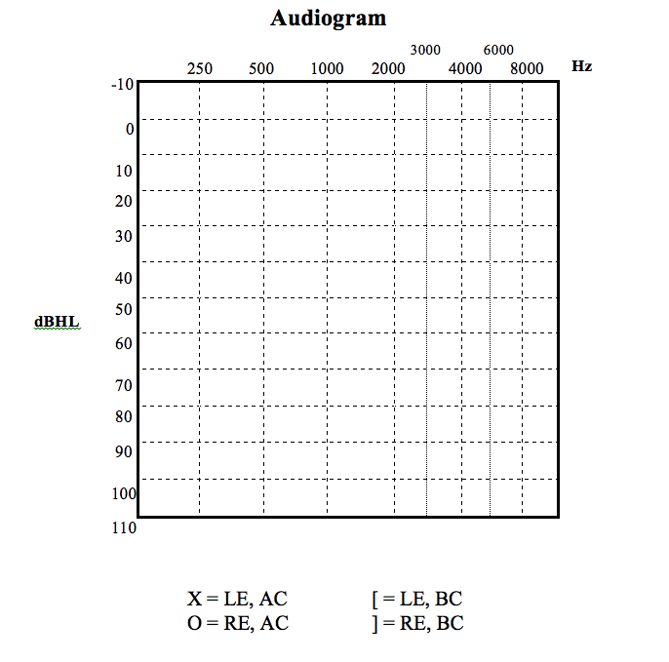
The traditional hearing test – the pure tone
The “classic” article by
Goldstein (1957) was
good and bad regarding
hearing of hemispherectomy
XO XO XO XO XO XO
N O R M A L
M I L D
M O D E R A T E
S E V E R E
P R O F O U N D
(Musiek)

Slide 9
SOME TESTS THAT ASSESS THE INTEGRITY OF THE CENTRAL AUDITORY SYSTEM FOR
WHICH THERE HAS BEEN A REASONABLE AMOUNT OF RESEARCH…….
Dichotic Listening: the presentation of two different acoustic signals
to each ear at the same time.
Speech in Noise: Speech signals embedded in a background of noise
Localization: locating a sound source in a sound field

Slide 10
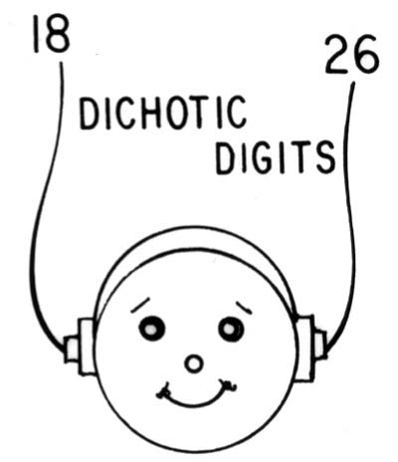
Examples of Dichotic Listening
2,8
Run
ba
1,4
Sun
da
Dichotic
digits
Dichotic
words
Dichotic
CVs
(Musiek)

Slide 11
ear
ear
Contralateral ear
(to the lesion hemisphere)
Ipsilateral ear
(to the lesioned hemisphere)
(Musiek)

Slide 12
ear
ear
Ipsilateral ear
(to the lesioned hemisphere)
Contralateral ear
(to the lesion hemisphere)
Musiek

Slide 13
From Waddington

Slide 14
RH
LH
CC
Contralateral nerve fibers = 80%
Ipsilateral nerve fibers = 20%
RE
LE
(dog)
(cat)
Normal Listening Function
(Musiek)

Slide 15
RH
LH
CC
RE
LE
(dog)
(cat)
Normal Dichotic Listening Function
(Musiek)

Slide 16
Dichotics and Hemispherectomies
IE
IE
%
AGE = 10 -22 yrs
Age @ surgery = 1½ - 10 yrs
RE = right ear
LE = left ear
IE = ipsilateral ear
CE = contralateral ear
CE
CE
Dichotic CVs
Dichotic fused words
Bode et al. 2007 (modified)
Berlin (1975), Wester et al. (1991)
reported similar results.

Slide 17
IE
%
RE
AGE =14 (mean)
IE
LE
CE
RE = right ear
LE = left ear
IE = ipsilateral ear
CE = contralateral ear
CE
Controls
N=15
Congenital
Hemispherectomy
N=6
Later
Hemispherectomy
N=6
(Netley et. al. 1972)

Slide 18
Speech in Noise……
Say the word run = in quiet
Say the word run
= noise competition (visual analog)

Slide 19
Speech in Noise and Hemispherectomies (N=2, LH, RH)
AGE = 8 yrs
Age @ surgery = 8 yrs
A
= Pre Op.
= Post Op.
Left
hemispherectomy
Right
hemispherectomy
A = Linear Z scores converted to SCAN scores X 10
for display
Boatman et al. 2003 (modified)

Slide 20
Localization task……..
Multiple speakers
Listener
Musiek

Slide 21
Localization (fixed)
30
15
0
xX
O
hemispherectomy
Mean
Deviation
Scores
(error)
O
x
I = ipsilateral field
PC = peri central field
C = contralateral field
O
X
controls
X
I
PC
C
Modified from Poirier et al. 1994
Similar results from Zattore (1995)

Slide 22
Localization (moving)
30
15
0
xX
O
hemispherectomy
O
Mean
Deviation
Scores
(error)
X
X
controls
O
X
I
PC
C
*ave. of 3 sources….
Modified from Poirier et al. 1994
Similar results from Lessard et al. 1999

Slide 23
WHY DO SOME DO WELL, OTHERS NOT ?
PLASTICITY
TIMING, (onset of disorder, surgery) DURATION
EXPERIENCE – TRAINING
EXPERIENCE WITH DYSFUNCTION (1 VS. 2 HEMISPHERES)

Slide 24
WHAT CAN BE DONE ?
Auditory Training ?
Dichotic interaural intensity training (DIID)
Training on the defined deficit

Slide 25
What to Watch for: Some Symptoms of CAPD
Difficulty in noisy environments
Difficulty in reverberation
Difficulty following multi-step directions
Appears to have problems listening
Difficulty following fast, soft talkers
Misinterprets words, numbers, etc
Challenged by language based subjects in school
Symptoms with a “normal” audiogram

Slide 26
RESEARCH NEEDS low medium high
Dichotic x
Localization x
Temporal x
Speech (low redundancy) x
Electrophysiologic x
Test battery x
Rehabilitative x
*
Complete feedback survey !!!

Slide 27
Thank You !

